Slide 1



AtliQ
GoodCabs
Analysis
Presented By -Rohit Kumar

Slide 2

CONTENT
Company Overview
Problem Statement
Dataset & Model
Dashboard
Ad-Hoc, Primary Analysis & Insights
Secondary Analysis / Suggestions

Slide 3
COMpany’s Overview
Established: Two years ago, Goodcabs is a cab service company operating in the Indian market.
Market Focus: Specializes in tier-2 cities across India, with operations in 10 cities.
Unique Commitment: Supports local drivers, enabling them to sustain a living in their hometowns.
Passenger Service: Ensures excellent service quality for passengers.
2024 Goals: Aims to achieve ambitious performance targets to drive growth and improve passenger satisfaction.

Slide 4
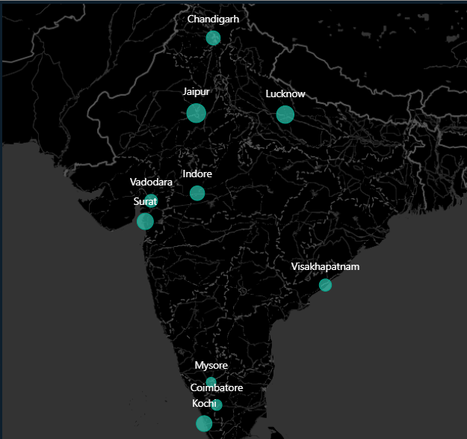
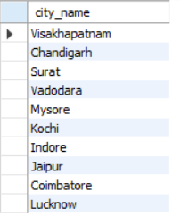
CITIES

Slide 5
Problem Statement
Despite operating in tier-2 cities for two years, Goodcabs has not achieved significant market penetration. To address this challenge, the company seeks a deeper analysis of the last six months of data to identify gaps and generate a comprehensive report for actionable insights.
Objective:
To conduct a detailed performance analysis across key metrics, enabling Goodcabs to identify areas of improvement, optimize operations, and drive market penetration in tier-2 cities.
Ad-hoc Analysis: Address specific, immediate insights.
Primary Analysis: Evaluate key performance metrics.
Secondary Analysis: Explore broader trends and relationships.

Slide 6
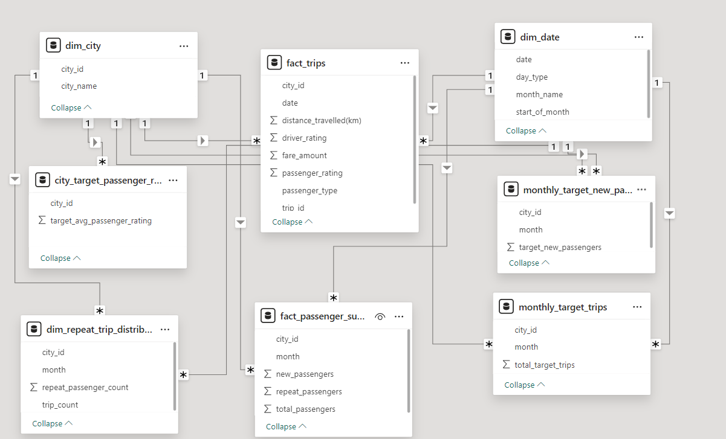
Dataset & Model
Dim_date
Dim_city
Dim_repeat_trip_distribution
Fact_trips
Fact_passenger_summary
Monthly_target_trips
Monthly_target_new_passengers
City_target_passenger_rating
Tools Used:
PowerBI, MySQL and Excel

Slide 7
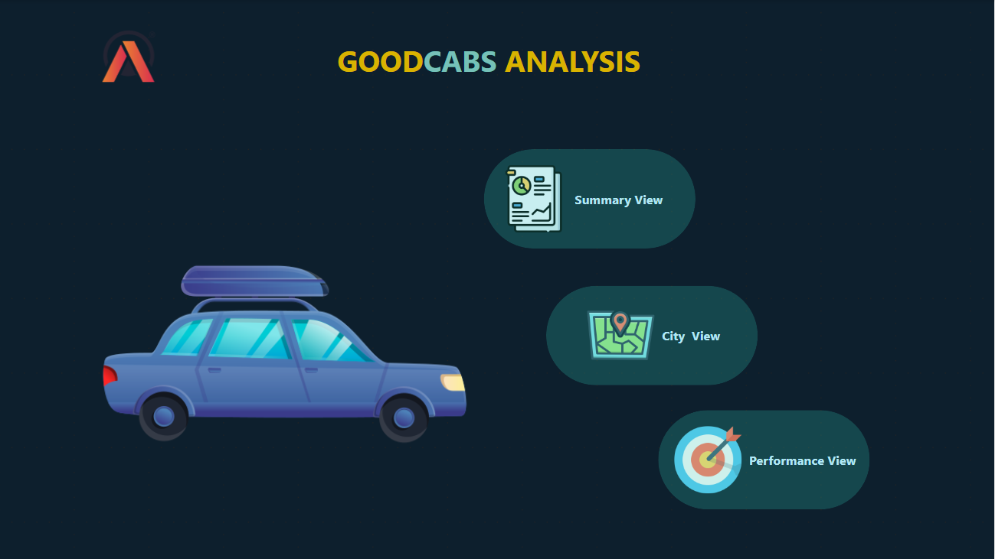
Dashboard

Slide 8
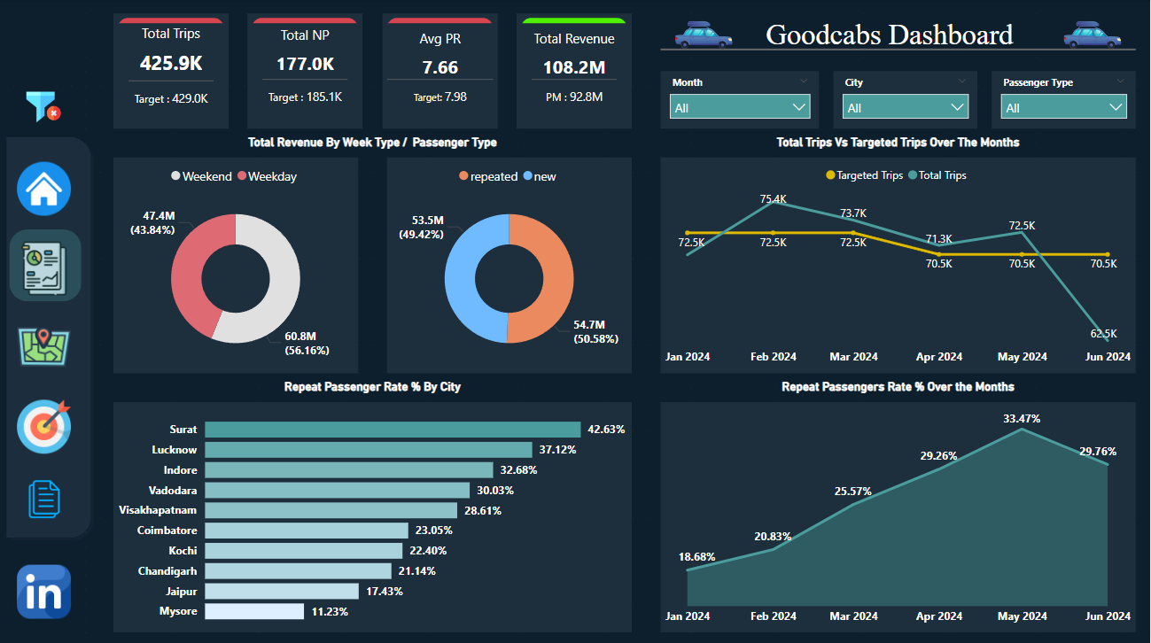
Dashboard

Slide 9
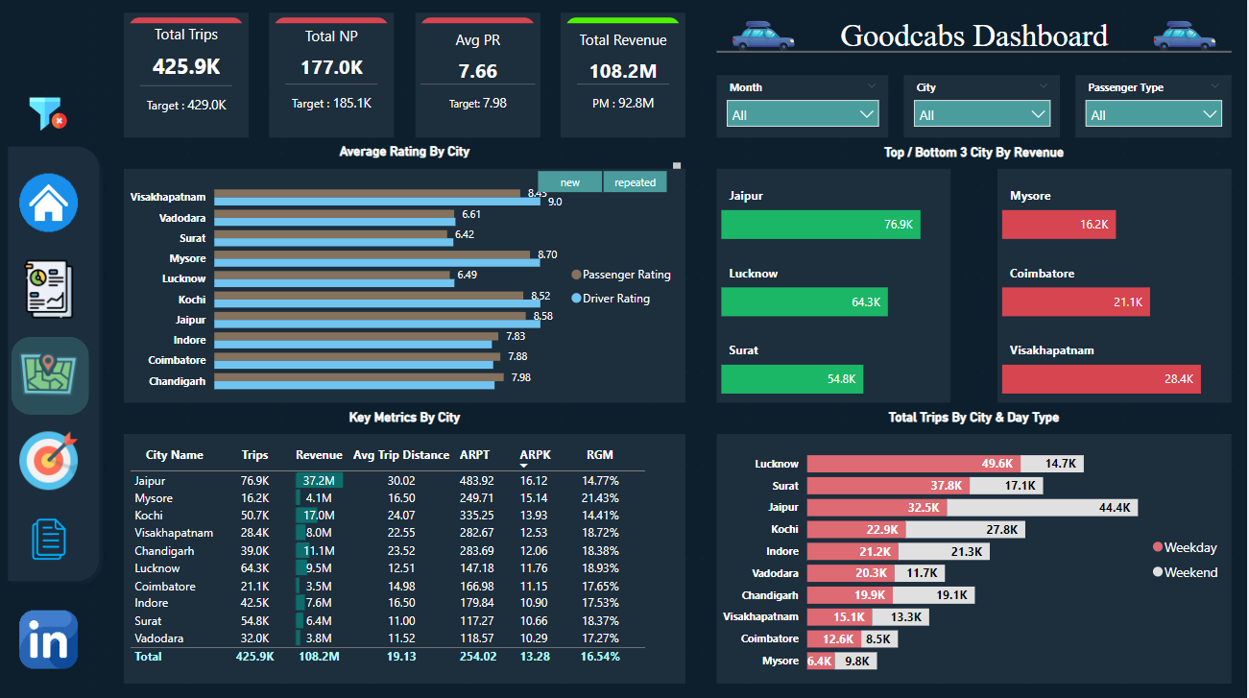
Dashboard

Slide 10
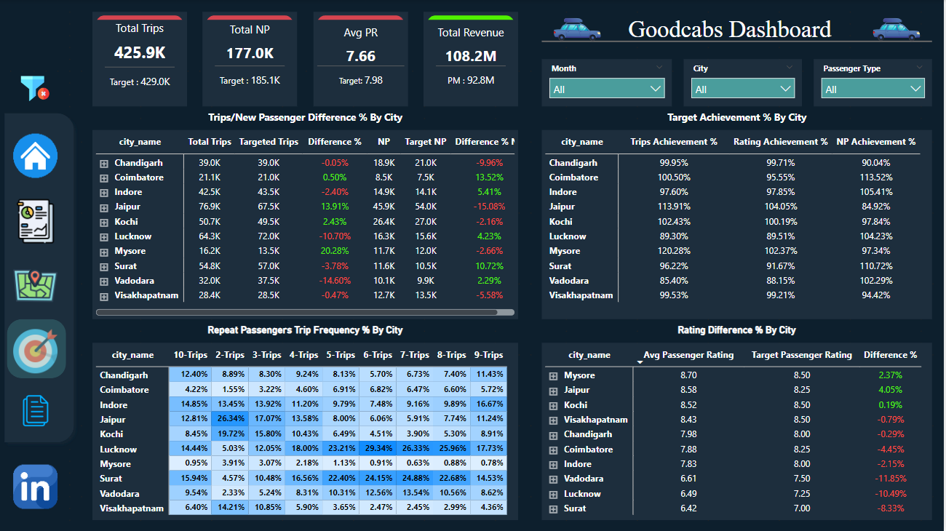
Dashboard

Slide 11
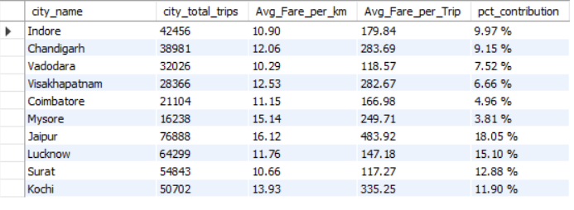
AD-HOC Requests
Business Request 1: City-Level Fare And Trip Summary Report
Output:

Slide 12
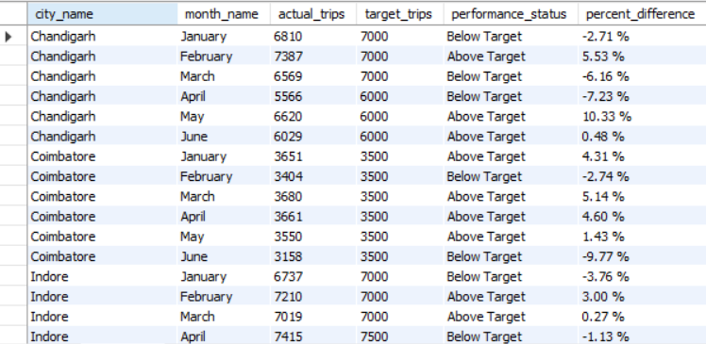
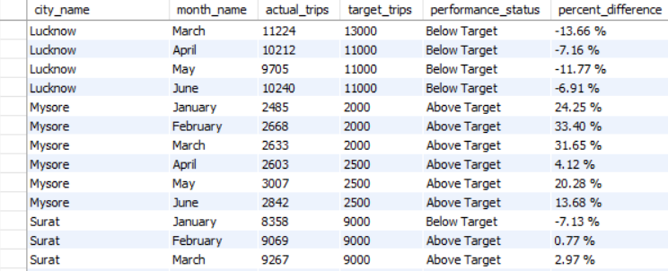
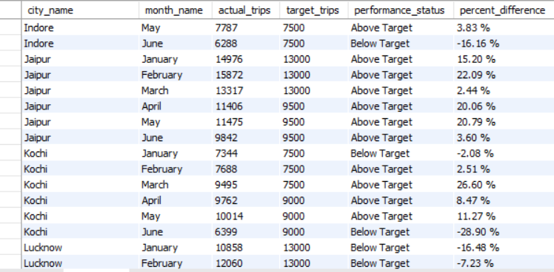
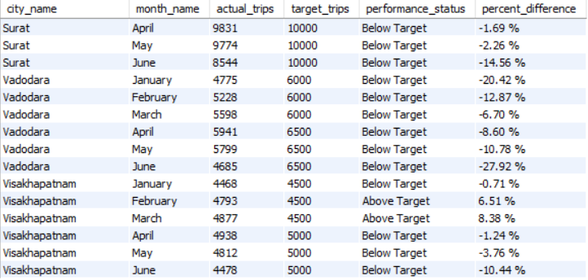
AD-HOC Requests
Business Request 2: Monthly City-Level Trips Target Performance Report
Output:

Slide 13
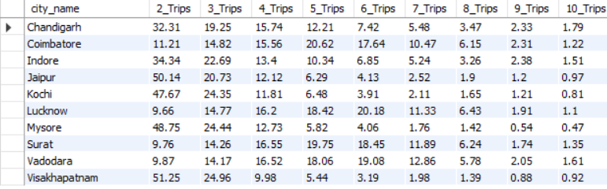
AD-HOC Requests
Business Request 3: City-Level Repeat Passenger Trip Frequency Report
Output:

Slide 14
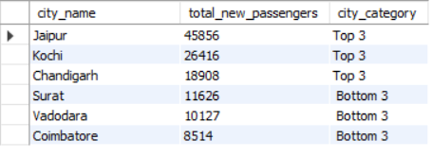
AD-HOC Requests
Business Request 4: Identify Cities With Highest And Lowest Total New Passengers
Output:

Slide 15
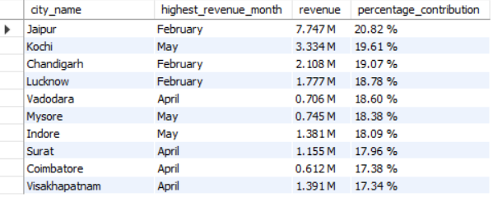
AD-HOC Requests
Business Request 5: Identify Month With Highest Revenue For Each City
Output:

Slide 16
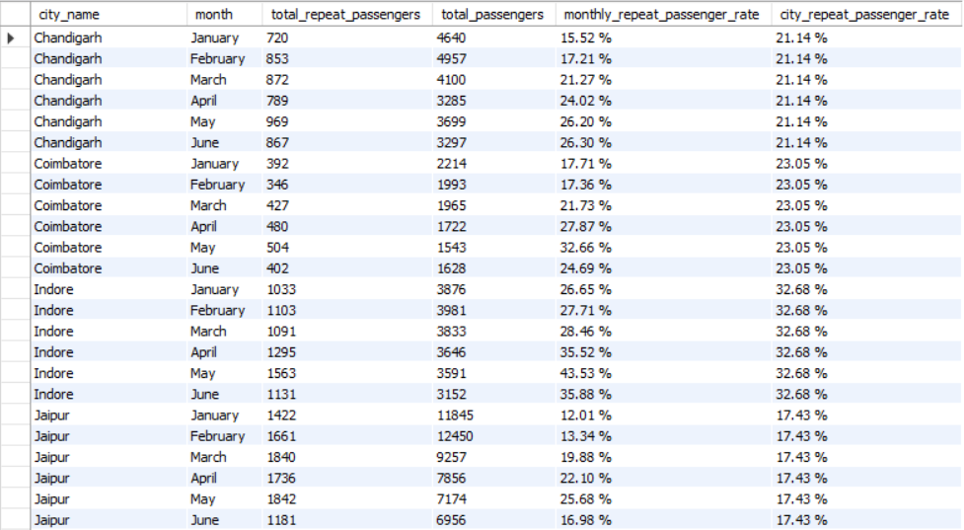
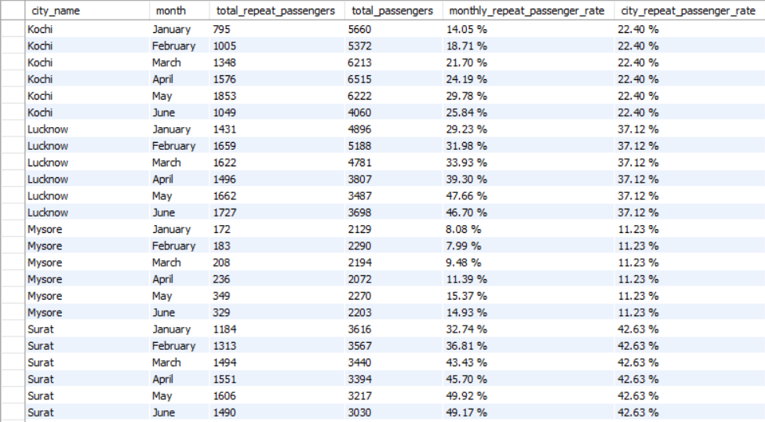
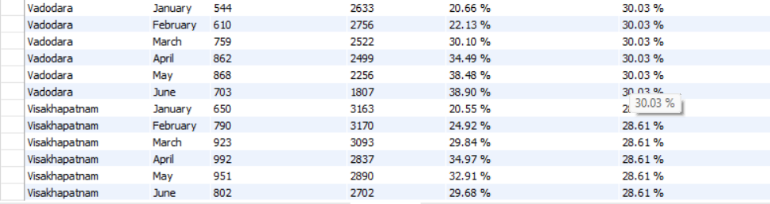
AD-HOC Requests
Business Request 6: Repeat Passengers Rate Analysis
Output:

Slide 17
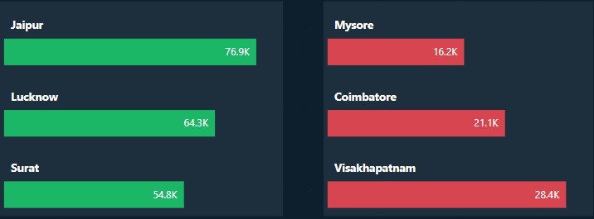
Primary Analysis
Q1) Identify the top 3 and bottom 3 cities by total trips over the entire analysis period.
Insights:
Leading Cities by Total Trips: Jaipur, followed by Lucknow and Surat.
Cities with Lowest Total Trips: Visakhapatnam, followed by Coimbatore and Mysore.

Slide 18
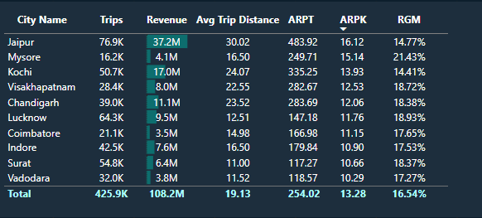
Primary Analysis
Q2) Calculate the average fare per trip for each city and compare it with the city’s average trip distance. Identify the cities with the highest and lowest average fare per trip to assess pricing efficiency across locations
Insights:
Jaipur has the highest average revenue per trip(ARPT) followed by Kochi, while Surat has the lowest also the lowest average trip distance followed by Vadodara.
Average revenue per km(ARPK) was highest for Jaipur around 16.12 and lowest for Vadodara 10.29
Revenue growth monthly was highest for Mysore at 21.43% followed by Lucknow at 18.93%.

Slide 19
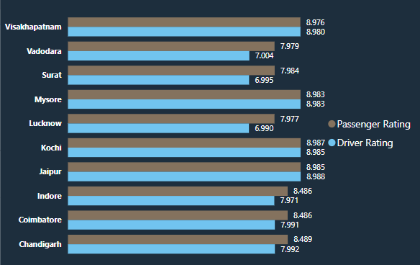
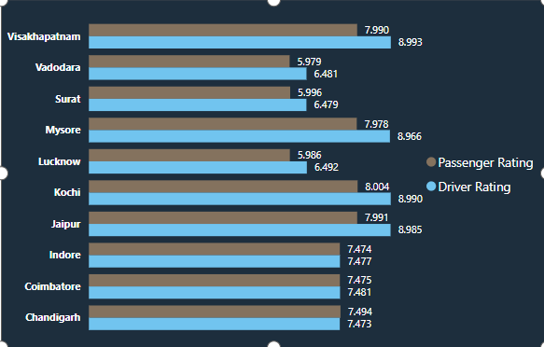
Primary Analysis
Q3) Calculate the average passenger and driver ratings for each city, segmented by passenger type(new vs repeat). Identify cities with the highest and lowest average ratings.
new
repeat
Insights:
Highest Average Passenger Rating: Kochi for both new and repeat passenger types.
Lowest Average Passenger Rating: Vadodara (5.979) for repeat passengers and Lucknow (7.977) for new passengers.
Highest Average Driver Rating: Jaipur for new passengers and Visakhapatnam for repeat passengers.
Lowest Average Driver Rating: Lucknow (6.990) for new passengers and Surat (6.479) for repeat passengers.

Slide 20
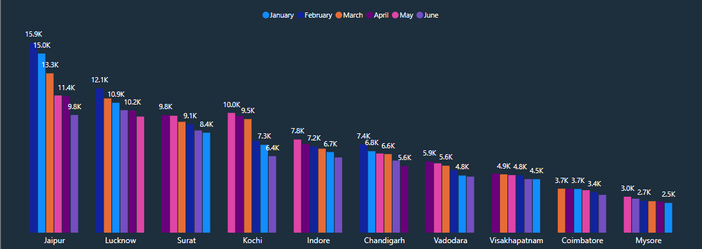
Primary Analysis
Q4) For each city, Identify the month with the highest total trip and the month with the lowest total trips.
Insights:
Peak Months: February, April, and May.
Highest Total Trips: Most cities recorded their highest trips during these months, except Coimbatore (March).
Lowest Total Trips: January and June for most cities, excluding Chandigarh(April) and Lucknow(May).

Slide 21
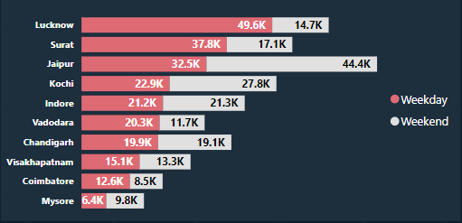
Primary Analysis
Q5) Compare the total trips taken on weekdays vs weekends for each city over the six-month period. Identify cities with a strong preference either for weekday or weekend trips to understand demand variations
Insights:
In most cities, weekdays were the preferred days for trips, except in Mysore, Jaipur, Indore, and Kochi.
Lucknow and Surat showed a strong preference for weekdays, while Jaipur and Kochi favoured weekends.

Slide 22
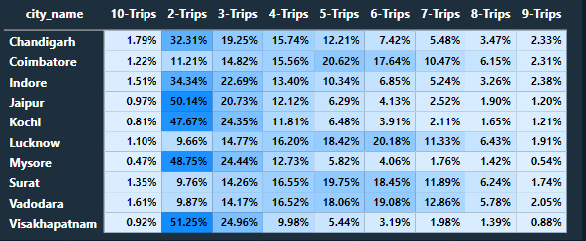
Primary Analysis
Q6) Analyse the frequency of trips taken by repeat passengers in each city (e.g. % of repeat passengers taking 2 trips, 3 trips, etc). Identify which cities contribute most to higher trip frequencies among repeat passengers, and examine if there are distinguishable patterns between tourism-focused and business-focused cities.
Insights:
Tourism-Based Cities: Jaipur, Kochi, Mysore, and Visakhapatnam saw higher 2 and 3-trip counts, with a decline as trip counts increased.
Business-Based Cities: Trip percentages increased with higher trip counts.
Repeat Passenger Contribution: Lucknow, Vadodara, Surat, Coimbatore, and Chandigarh contributed most to higher trip frequencies among repeat passengers.

Slide 23
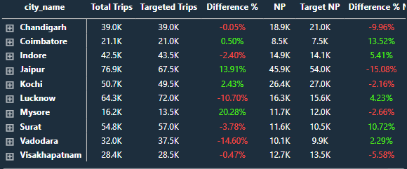
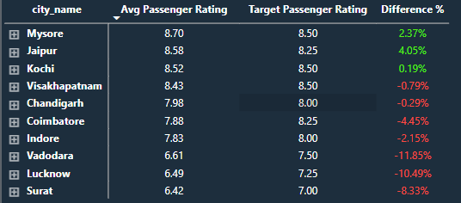
Primary Analysis
Q7) For each city, evaluate monthly performance against targets for total trips, new passengers, and average passenger ratings. Determine if each metric met, exceeded or missed the target and calculate the percentage difference. Identify any consistent patterns in target achievement, particularly across tourism vs business-focused cities
Insights:
Visakhapatnam: Failed to meet all targets and requires immediate attention.
Tourism Cities: Met passenger rating targets but struggled with total trips; business cities exceeded new passenger targets but faced challenges with ratings and total trips.
Target Performance: Only Mysore, Jaipur, and Kochi met passenger ratings, while Coimbatore, Jaipur, Kochi, and Mysore met total trip targets; Coimbatore, Indore, Lucknow, Surat, and Vadodara exceeded new passenger targets.

Slide 24
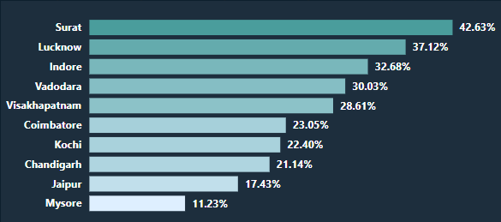
Primary Analysis
Q8) (a)- Analyse the repeat passenger rate(RPR%) for each city across the six-month period. Identify the top 2 and bottom 2 cities based on their RPR% to determine which location has the strongest and weakest rates.
Insights:
Surat had the highest RPR% at 42.63%, followed by Lucknow at 37.12%.
Mysore had the lowest at 11.23%, with Jaipur coming in second at 17.43%.

Slide 25
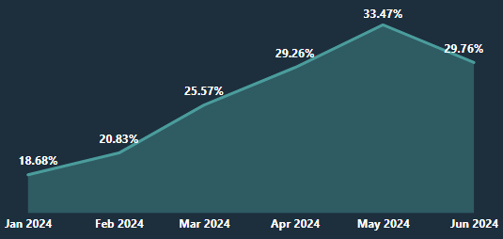
Primary Analysis
Q8) (b)- Similarly, analyse the RPR% by month across all cities and identify the months with the highest and lowest repeat passengers rates.This will help to pinpoint any seasonal patterns or months with higher repeat passenger loyalty.
Insights:
May had the highest RPR% at 33.47%, followed by June at 29.76%.
January had the lowest at 18.68%, with February close behind at 20.83%.

Slide 26
Secondary Analysis
Q1) Factors Influencing Repeat Passenger Rates
Good service, reliability, and competitive pricing tend to boost repeat usage, especially in price-sensitive cities.
Younger, tech-savvy populations and higher income levels often lead to higher repeat rates, while lower-income areas may have lower rates.
Cities with frequent commuters or fewer transportation options usually see higher repeat rates, while tourist-heavy cities or those with more competition might see lower rates.

Slide 27
Secondary Analysis
Q2) Tourism Vs Business Demand Impact
Suggestions:
Festivals and conferences boost demand, creating opportunities for targeted promotions to increase trip volume during these times.
Peak travel times, like holidays or winter months, lead to higher demand, especially in tourist cities. Tailoring marketing efforts can capture more riders.
By aligning marketing strategies with local events and tourist seasons, we can increase our brand visibility, attract more riders, and potentially see a boost in trip volume. Offering event-specific discounts, ride packages, or easy access to transportation during peak times can also enhance customer loyalty and capture a larger share of the market.

Slide 28
Secondary Analysis
Q3) Emerging Mobility Trends and Goodcabs Adaption
Source - The Financial Express
Benefits - Reduced GST on EVs(5%), can claim 40% depreciation in the first year, reduced operational costs
Suggestions:
As more people care about the environment, EVs are becoming popular for their eco-friendly benefits and cost savings. Adding EVs to Goodcabs' fleet could attract more customers who value sustainability.
Using renewable energy, like solar power for charging EVs, would enhance Goodcabs' eco-friendly image and appeal to environmentally conscious riders.
By integrating EVs and green initiatives, Goodcabs can stand out in tier-2 cities, attracting customers who want to support eco-friendly businesses.

Slide 29
Secondary Analysis
Q4) Partnership Opportunities With Local Businesses
Suggestions:
offering special ride packages or discounts for hotel guests or tourists visiting local events can increase trip volume and attract repeat passengers.
Collaborations with malls and event venues can attract more passengers, especially during peak times.
Partnerships with local businesses for loyalty programs can boost repeat customers and strengthen brand recognition.

Slide 30
Secondary Analysis
Q5) Data Collection for Enhanced Data-Driven Decisions
Suggestions:
Passenger Demographics Data: Gather data on passengers' age, gender, and preferences to better tailor our services.
Market Share/Competitor Data: Track market position to stay competitive and identify areas for growth.
Ride Cancellation Data: Monitor cancellations to understand why they happen and improve service.
Feedback Data: Collect customer reviews to improve service and address issues.
Preferred Payment Mode Data: Track payment preferences to offer the most convenient options.
Fleet Utilization Data: Monitor fleet usage and idle times to optimize fleet size, reduce downtime, and improve operational efficiency.

Slide 31
Thank You
For your valuable time.

